Slide 1
Towards Evidence Based Policy in the Sphere of Families and Children in Bulgaria
Professor Tatyana Kotzeva, PhD
Associate Prof. Elitsa Dimitrova, PhD
Institute of Population and Human Studies at the Bulgarian Academy of Science

Slide 2
Demographic Challenges & Family Policy
Demographic challenges: low birth rates, ageing populations, ageing labor force, diversity of living arrangements, including family diversity, economic hardships and increasing social inequalities;
Family policy - set of financial benefits (cash and in-kind) and services (health, educational and social) to improving family functioning and grounding child-rearing;
Basic principles of family policy:
family and children’s needs;
children’s rights (best interest of children) and a right of family life’ inviolability.

Slide 3
Values and Priorities of Family Policy
Family policy – a balance between private and public aspects of family life→ SUPPORT to Families, NOT intrusion; the key concept – TRUST;
Positive parenting: parental behaviour based on the best interests of the child that is nurturing, empowering, non-violent and provides recognition and guidance which involves setting of boundaries to enable the full development of the child (Council of Europe, Rec 2006; Daly and Abela et al 2007).

Slide 4
Family policy and cultural norms
Respondents in Bulgaria are the most likely to stereotype based on gender (Eurobarometer 2017 ‘Gender Equality’)
Gender Equality Index BG (EIGE) - 2019

Slide 5
Gender Equality Index BG (EIGE) - 2019

Slide 6
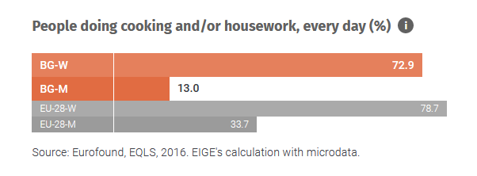
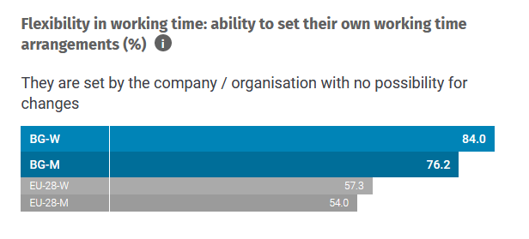
Gender Equality Index BG (EIGE) - 2019

Slide 7
Family Policy: gaps and directions
Alternative childcare services up to 3 years
Paid childcare services at home
Quality of childcare services
Evaluation studies on the effects of programs and policy measures.
Family policy priorities according to socio-economic status of parents:
monetary benefits for low status families
work-life balance and quality of childcare services
Activating parents’ participation in institutions – working for parents→ working WITH parents

Slide 8
Main results from a national representative survey „Attitudes towards Fertility, Family Policy and Vulnerable Groups“ (2018)

Slide 9
Description of the study:
The national representative survey „Attitudes towards Fertility, Family Policy and Vulnerable Groups“ conducted as part of the project “Measures to Cope with the Demographic Crisis in Republic of Bulgaria” coordinated by IPHS at BAS (2017-2018)
1 506 people at age 18-50 (women) and 18-55 (men) interviewed in March-April 2018;
The main topics covered in the questionnaire:
Reproductive behaviors, fertility intentions and union formation;
Values and norms related to family, parenthood and partnership;
Life-work balance;
Attitudes towards policy measures for families and children.

Slide 10
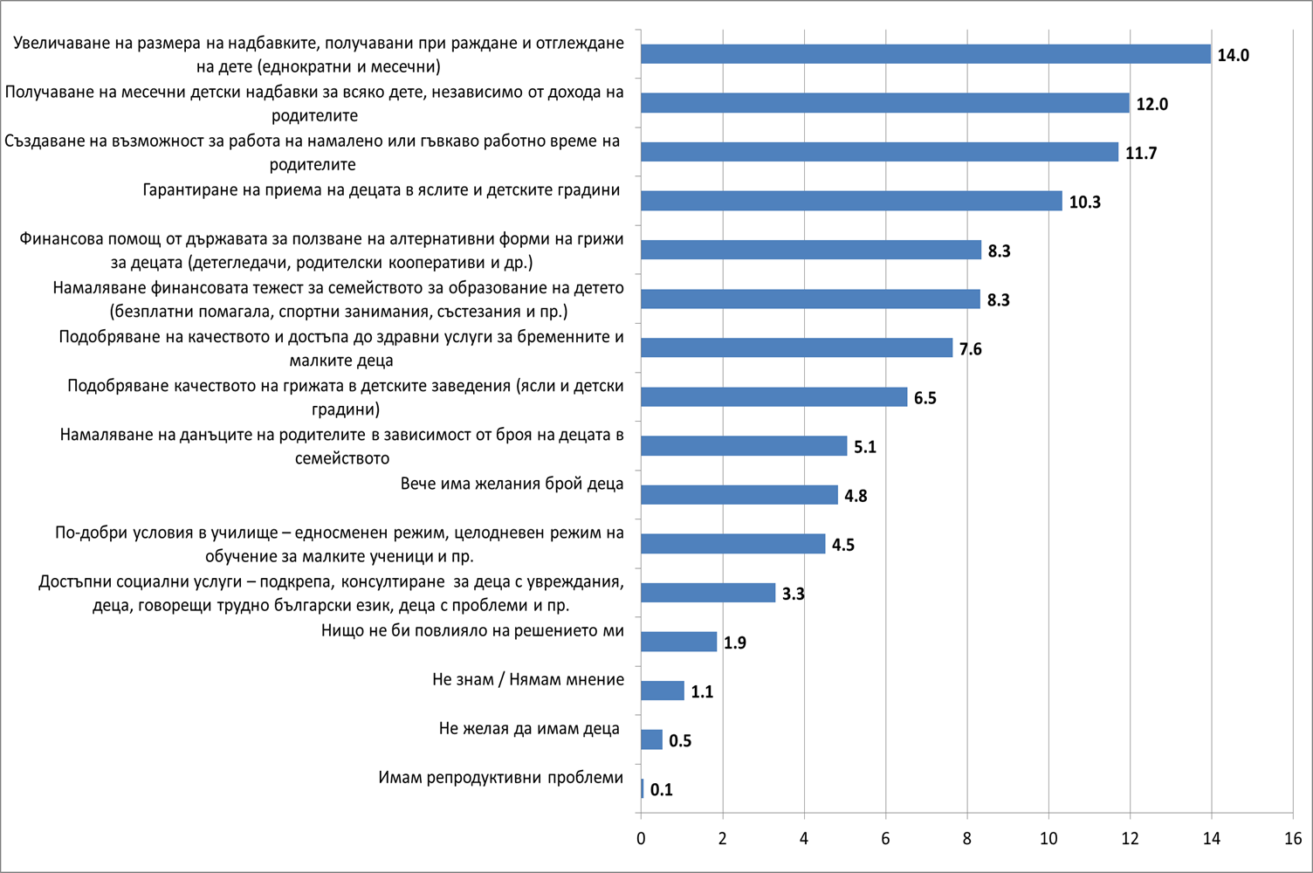
Which policy measures could influence your decision to have (another) child? – up to 5 responses

Slide 11
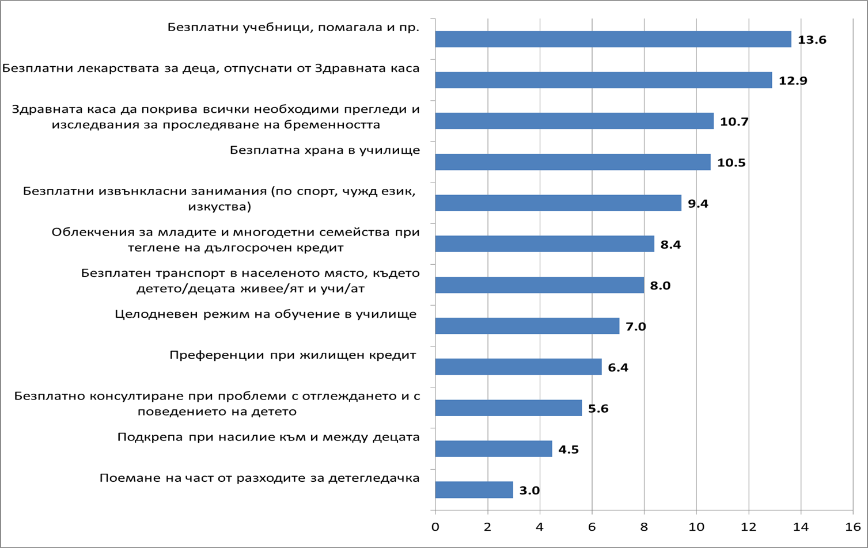
In your opinion, which services should the state guarantee for families and children? – up to 5 responses

Slide 12
Main results
Strong support of the financial measures for families and children;
Increase of the child benefits and introduction of universal coverage of the payments regardless of family income.
Strong preferences for available and high quality services for families and children:
High quality and free of charge education in pre/schools;
Available and high quality health care – more referrals for (specialized) medical checkups and free of charge medicines for children;
Flexible working time for parents with small children;
Guaranteed access to crèches and kindergartens for all children;
Tax reduction dependent on the number of children in family;
Access to alternative childcare services - (babysitters and babysitting cooperatives) ;
Support for child adoption and foster care.

Slide 13
Social differences in the attitudes towards family policy
Strong differences in the attitudes towards family policy by education, place of residence and income:
People living in the capital of Sofia or the big cities; with high education and income higher than the average for the country have stronger preferences towards measures of high quality services for children and families and flexible working time.
People living in the small residential places, with lower education and lower income give priority to the financial state support – higher child benefits and increased state financial support for education and healthcare for children.

Slide 14
Thank you for your attention!

